Slide 1

Thinking About the Business of Behavioral Health in Primary Care
Virna Little, PsyD, LCSW,SAP, CCM

Slide 2

Common Pitfalls
The land of perpetual launch
Claim forms incorrect
No real organizational focus/no dedicated staffing
Not doing anything “different”, same staffing/approaches , population health
This Photo by Unknown Author is licensed under CC BY-NC

Slide 3

Painting a Picture: Knowledge is Key
Figuring sustainability has many different pieces-be informed
Productivity is only one- often the one that gets the most emphasis ( The P word !!)(wrongly by most organizations)
Know all of the “colors” in your behavioral health business painting ( case rates, transitions)
Where most behavioral health providers in
Primary care struggle is scheduling- also costs
the most in lost revenue………..

Slide 4

Some Primary Care Changes
The AMA developed CPT® code 99417 for 15 minutes of prolonged care, done on the same day as office/outpatient codes 99205 and 99215.
Medicare has assigned a status indicator of invalid to code 99417, and developed a HCPCS code to replace it, G2212
If using either code, only report it with codes 99205 and 99215, use only clinician time, and use it only when time is used to select the code
There are nuances here but worth looking into ………..

Slide 5





Important to Understand Collaborative Care
PRACTITIONER
PATIENT
BEHAVIORAL
CARE MANAGER
REGISTRY
PSYCHIATRIC CONSULTANT
Source
The AIMS Center at the University of Washington developed this visual representation of the Collaborative Care Protocol
Notes:
UW’s Aims Center developed the Collaborative Care protocol from the IMPACT study
This triangle illustrates the connection between you, the patient and the two new care team members that CH introduces through collaborative care - a behavioral care manager and a psychiatric consultant – they will work alongside your providers to treat patients with anxiety or depression and we keep a registry of these patients while also maintaining your EMR up to date with the patient’s clinical progress throughout the month

Slide 6
Collaborative Coding Non FQHC
BHI Code | Behavioral Health Care Manager or Clinical Staff Threshold Time | Activities Include:
CoCM First Month (CPT 99492) | First 70 minutes per calendar month | Initial Assessment Outreach/engagement Entering patients in registry Psychiatric consultation Brief intervention
CoCM Subsequent Months (CPT 99493) | 60 minutes per calendar month | Tracking + Follow-up Caseload Review Collaboration of care team Brief intervention Ongoing screening/monitoring Relapse Prevention Planning
Add-on CoCM (Any month) (CPT 99494) | Each additional 30 minutes per calendar month | Same as Above
General BHI (CPT 99484) | At least 20 minutes per calendar month | Assessment + Follow-up Treatment/care planning Facilitating and coordinating treatment Continuity of care

Slide 7
BHI Coding Summary FQHC
BHI Code | Behavioral Health Care Manager or Clinical Staff Threshold Time | Activities Include:
CoCM First Month (G0512) | First 70 minutes per calendar month | Initial Assessment Outreach/engagement Entering patients in registry Psychiatric consultation Brief intervention
CoCM Subsequent Months (GO511) | 60 minutes per calendar month | Tracking + Follow-up Caseload Review Collaboration of care team Brief intervention Ongoing screening/monitoring Relapse Prevention Planning

Slide 8
The Newest Collaborative Care Code
Added new HCPCS code G2214 - Initial or subsequent psychiatric collaborative care management, first 30 minutes in a month of behavioral health care manager activities, in consultation with a psychiatric consultant, and directed by the treating physician or other qualified health care professional
Added CY 2021 MPFS Final Rule CMS-1734-F Updates

Slide 9
99484
99484– Care management services for behavioral health conditions - At least 20 minutes of clinical staff time per calendar month. Must include:
• Initial assessment or follow-up monitoring, including use of applicable validated rating scales;
• Behavioral health care planning in relation to behavioral/psychiatric health problems, including revision for patients who are not progressing or whose status changes;
• Facilitating and coordinating treatment such as psychotherapy, pharmacotherapy, counseling and/or psychiatric consultation; and
• Continuity of care with a designated member of the care team.

Slide 10

Time Based Inclusions
Psychiatric consultation
Discussions, case reviews with primary care
Registry management
Telephonic work
Discussions with collaterals
In person visits ( to be continued)
If its not documented its not done !
Case management/concrete services carved out
90% attached to billable event (10% capacity)
90% of events billable
This Photo by Unknown Author is licensed under CC BY-NC-ND

Slide 11
ILLUSTRATIVE ECONOMICS
Per Patient Per Month
Per Provider*
*Will vary with payer mix and collection rate
Mean Monthly Revenue per patient | 150.00
Patient Co-Pay Bad Debt Allowance (50%) | -$X
Collections Expense (5%) | -$X
 | =
Net Collections | $XXX
Incremental Margin (Per Patient Per Month) | $XX
Practice Margin (%) | XX%
Provider FTE | Incremental Practice Margin ($, per year)
1 | $1800.00
50 | $90,000.00
100 | $180,000.00
Payor | Percentile
Medicaid | 150.00 (112.00)
Medicare | 180.00
Commercial | 90.00
Average caseload for care manager is 90

Slide 12
Co Pays
Patients with high deductibles
Specialty providers
Same as primary care visits not bh
May vary with plans

Slide 13
T1016
T1016 HO Case Management by Behavioral Health Professional - Office: Case management services (see general definition above for case management services) provided at the provider’s work site. Provider Qualifications: Behavioral health professional Billing Unit: 15 minutes
T1016 HO Case Management by Behavioral Health Professional - Out-of-Office: Case management services (see general definition above for case management services) provided at a person’s place of residence or other out-of-office setting. Provider Qualifications: Behavioral health professional Billing Unit: 15 minutes
T1016 HN Case Management - Office: Case management services (see general definition above for case management services) provided at the provider’s work site. Provider Qualifications: Behavioral health technician or Behavioral health paraprofessional Billing Unit: 15 minutes
T1016 HN Case Management - Out-of-Office: Case management services (see general definition above for case management services) provided at a person’s place of residence or other out-of office setting.
T1016 GT with Place of Service 02 Case Management – Telemedicine
T1016 with Place of Service 02 Case Management Telephonic Provider Qualifications: Behavioral health technician or behavioral health paraprofessional Billing Unit: 15 minutes

Slide 14
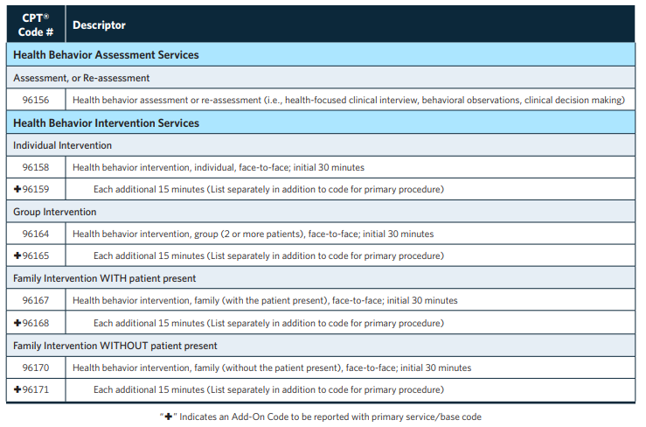
Health & Behavior Assessment & Intervention Codes

Slide 15
CCM-99490
Chronic care management services, at least 20 minutes of clinical staff time directed by a physician or other qualified health care professional, per calendar month, with the following required elements:
Multiple (two or more) chronic conditions expected to last at least 12 months, or until the death of the patient,
Chronic conditions place the patient at significant risk of death, acute exacerbation/decompensation, or functional decline,
Comprehensive care plan established, implemented, revised,

Slide 16

Behavioral Health Codes-Optimal
Behavioral health providers are licensed providers to treat mental illness….
Per CFR Title 42, Part 410.73(b)(1) the services of a clinical social worker are limited to the diagnosis and treatment of mental illness.

Slide 17

What is a
A 90839!
May not need authorization
Discontinue 60 minute visits that are not a crisis
Helps with VBP
Again, helps to paint the picture!

Slide 18
Depression Screening Simplified
Behavioral Health Screening Utilization: Depression
Code | Description
G8431 (with HD modifier) | # of individuals screening for clinical depression is documented as being positive and a follow-up plan is documented.
G8510 (with HD modifier, replaces 99420) | # of individuals screening for clinical depression is documented as negative, a follow-up plan is not required
CPT code 96127 | # of individuals screened with a brief emotional/behavioral assessment with scoring and documentation, per standardized instrument
G0444 | # individuals receiving annual depression screening, 15 minutes
CPT 96161 | Administration of caregiver-focused health risk assessment instrument (e.g., health hazard appraisal) with scoring and documentation, per standardized instrument - Maternal depression screening during well-child visit, billed using child’s ID number.

Slide 19
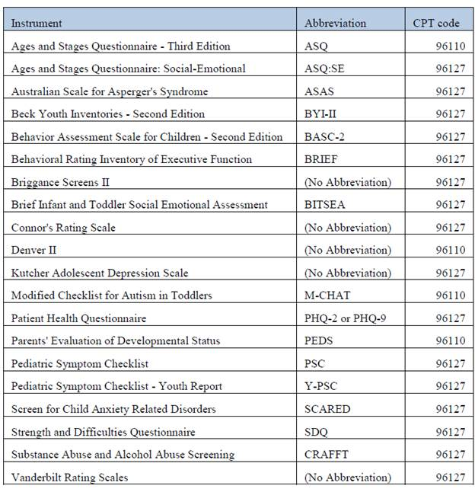

Slide 20
Review Payer Mix
What payers does your organization or BH services get reimbursement from
Make a grid to review each payers each service and each provider
Review guidelines for each payers- are services part of the contract or do they need to be added
Does the payer reimburse for all credentials, i.e. social workers vs. counselors
Special payer programs-like depression

Slide 21

Questions/Thoughts virna@concerthealth.io

