Slide 1
Linda S. Vail, MPA Ingham County Health Officer
www.healthycapitalcounties.org
Notes:
The Healthy! Capital Counties project began as a partnership between the four area hospital systems and the three local health departments serving Ingham, Eaton, and Clinton counties in December of 2010. The Patient Protection and Affordable Care Act requires non-profit hospitals conduct or participate in a “community health needs assessment,” partner with public health and the community, and develop an action plan to address health needs identified in the assessment.
The public health departments, while accredited at the state level in Michigan, must conduct a high-quality Community Health Assessment and Community Health Improvement Plan as a prerequisites to apply for voluntary national accreditation through the Public Health Accreditation Board.
Building on a regional history of cross-hospital system and cross-health department collaboration, the entities decided to partner collaboratively on this project to conserve and enhance the local capacity to do this work.
In June of 2012, the Healthy! Capital Counties project published the first Community Health Profile and Needs Assessment, with a key findings section added in August 2012. The second round of the community health improvement process was started in October 2014 and recently published.

Slide 2
Project Support
Hospitals
Eaton Rapids Medical Center
Hayes Green Beach Memorial Hospital
McLaren Greater Lansing
Sparrow Health System
Local Health Departments
Barry-Eaton District Health Department
Ingham County Health Department
Mid-Michigan District Health Department
Notes:
Here are the aforementioned project partners.

Slide 3
Community Health Assessment
& Health Improvement Plan
Data
Priorities
Strategies
Notes:
The community health improvement process yields two deliverables: a community health assessment presented in the form of a community health profile and a community health improvement plan.
The process engages community members and partners to systematically collect and analyze qualitative and quantitative health-related data from a variety of sources.
The community health profile informs community decision-making, the prioritization of health problems and the development and implementation of community health improvement plans.

Slide 4
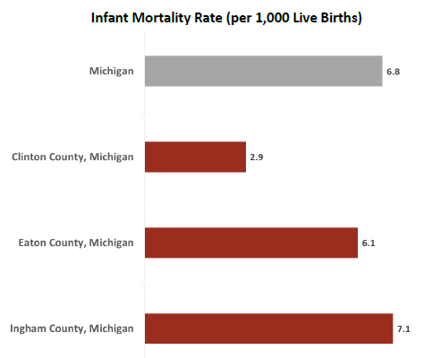
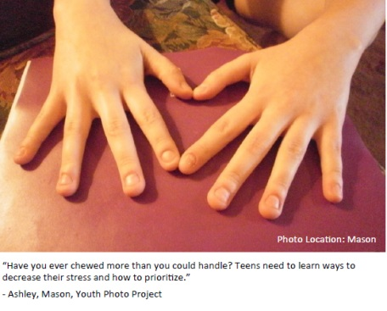
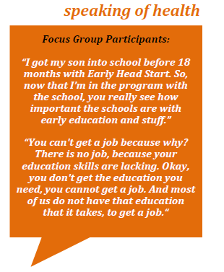
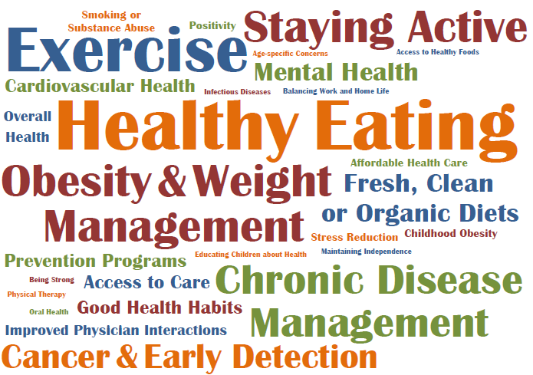
Data
Photo Voice
Focus Groups
Input Walls
Surveys
Notes:
We collected data and engaged the community in several different ways.
Data came from several sources including Behavioral Risk Factors Survey and MDHHS Vital Records.
The Photovoice project (new for this iteration of H!CC) sought to include the youth perspective. The project included 10 students from five different high schools.
For the focus groups, there were seven groups with an average of ten people in each group. They were designed to include traditionally underrepresented people.
The input walls asked people to define the characteristics of a healthy community. 131 individual answers were posted on the input walls at seven different locations.
We’ll discuss the surveys more later, but there were two. One was for community members and one was specifically for health care providers.

Slide 5
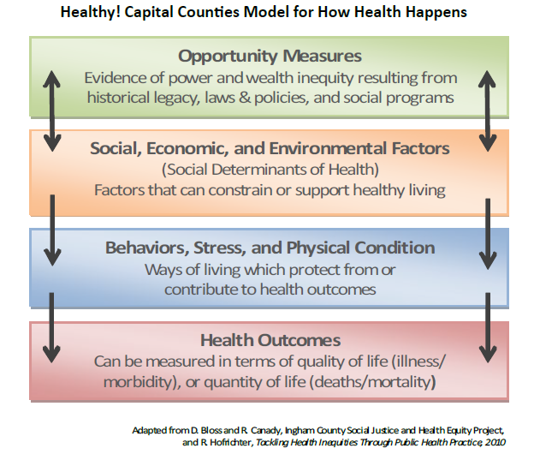
Notes:
Healthy! Capital Counties is concerned with the changeable aspects of health, and therefore does not address genetics or heritable diseases. While personal responsibility plays a role in each person’s individual health, it’s important to also consider other factors of social and collective responsibility to improve health.
Through H!CC, we examine health outcomes to determine patterns of disease and death across populations. Some of what influences health outcomes are health behaviors which protect from or contribute to health problems. These behaviors include things like smoking, drinking, or not having a primary care doctor. Also included are things that reflect physical or mental condition, such as obesity or poor mental health, which are often linked to poor health outcomes.
Over the past 30 years, researchers have found that social, economic, and environmental factors (the social determinants of health) predict which groups are more likely to have poor health outcomes and poor health behaviors. These factors examine concepts like lack of access to healthy foods, educational achievement, and exposure to childhood poverty. These disadvantages often pile up to make healthy living more challenging for some populations than for others.
Finally, we have opportunity measures which examine evidence of structural power and wealth inequities, factors that predict which groups of people will be challenged with poor social, economic, and environmental conditions. There is increasing evidence that income inequality and housing segregation are making us sick.

Slide 6
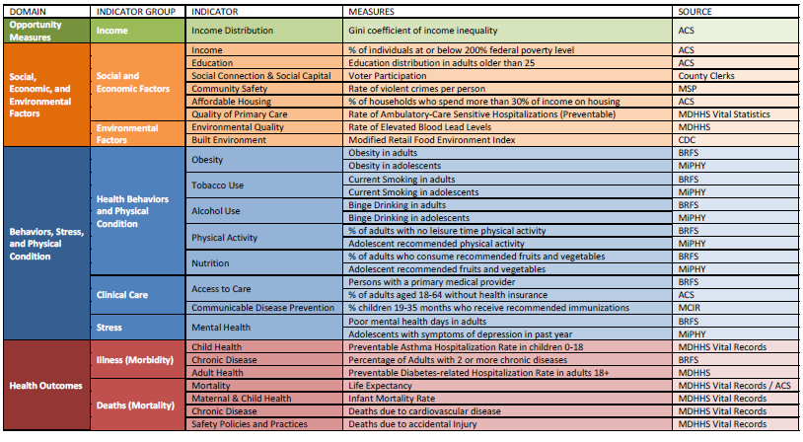
2015 Indicators
Notes:
Our “Rainbow Table”-- It incorporates our model for “how health happens” with some indicators and measures.

Slide 7
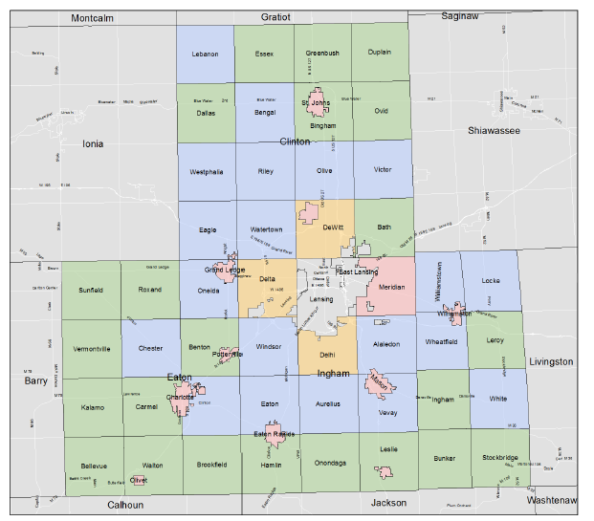
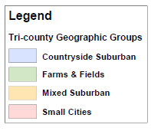
Notes:
Municipality Groups for Healthy! Capital Counties. H!CC looks at the capital area, but also sub-areas. We look at both municipalities and geographic groups.

Slide 8
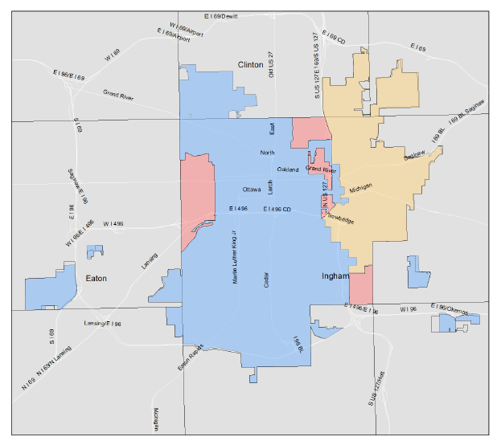
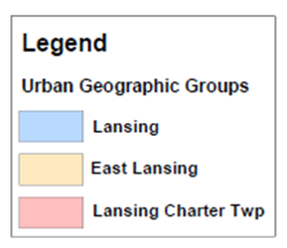
Notes:
Pause.
Now, I’d like to share some of the report’s findings that I thought might be of particular interest to you as physicians and primary care providers.

Slide 9
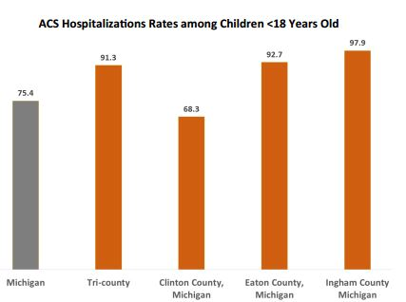
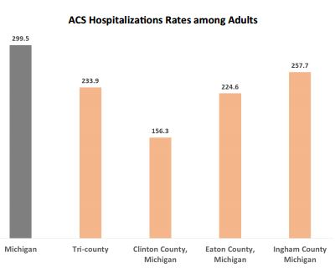
Quality of Primary Care
Measured by Ambulatory Care Sensitive Care Hospitalizations per 10,000
Notes:
Going back to our model for “how health happens,” we’re going to start at the top and work our way down, examining one or two indicators from each domain. Our only indicator for “Opportunity Measures” in H!CC is income distribution measured with Gini coefficient for income inequality. In the interest of brevity and our focus on health care, will tell you that Ingham County has slightly more income inequality than average in Michigan and that Clinton and Eaton Counties have more income equality than average. Typically countries with more income equality have better health, but neither perfect equality nor inequality is ideal.
We’re going move to “Social, Economic and Environmental Factors,” specifically “Quality of Primary Care.” High rates of ambulatory care sensitive (ACS) hospitalizations in a community are an indicator of a lack of (or failure of) prevention efforts, a primary care resource shortage, poor performance of primary health care delivery systems, or other factors that create barriers to obtaining timely and effective ambulatory care.
All three counties have lower rates of ACS hospitalizations than the state. When stratified by age, however, the region’s ACS hospitalization rate is higher than the state’s for children and lower than the state’s average for adults. Within the region and across all the age categories, Clinton Counties had the lowest ACS hospitalization rates followed by Eaton and Ingham counties.
Looking at our “Rainbow Table” (Social & Economic Factors), I’d like to add that in Ingham County at least we have a very high child poverty rate. Going down the “Rainbow Table” (Health Outcomes), I’d mention that preventable asthma hospitalizations among children is higher in the tri-county area than in the state.

Slide 10
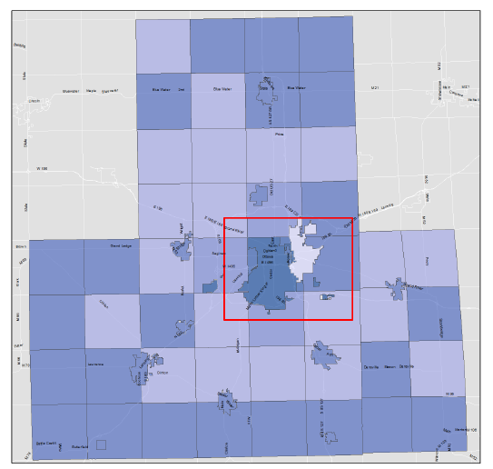
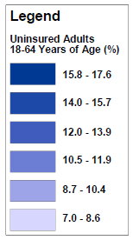
Uninsured
Notes:
We’re going to move to “Behaviors, Stress and Physical Condition.” Despite the increased access to health insurance resulting from the implementation of the Affordable Care Act, there are still adults with no health insurance. Overall, the proportion of adults 18-64 years old without health insurance is lower in the capital area than in the state, but that is not true for certain areas within the capital area. The city of Lansing has a slightly higher proportion of adults with no health insurance than the state.

Slide 11
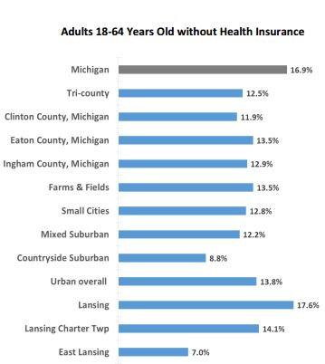
Notes:
This is the map presented as a bar chart.

Slide 12
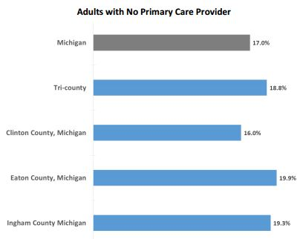
Access to Primary Care
Notes:
Of course, having access to care requires not only having financial coverage but also access to providers. While high usage of specialist physicians has been shown to be associated with higher, and perhaps unnecessary, utilization, having sufficient availability of primary care physicians is essential so that people can get preventive and primary care, and when needed, referrals to appropriate specialty care. Only Clinton County is better than the state average. Why?

Slide 13
Notes:
Here is what our focus group said. Is this true? For whom?

Slide 14
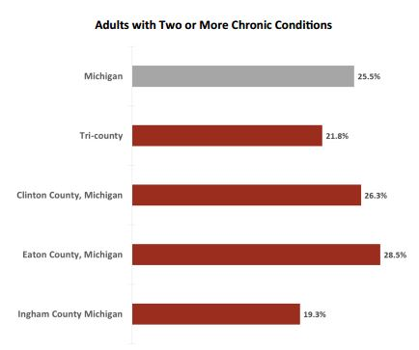
Chronic Disease
Notes:
We’re moving down one step to “Health Outcomes” now. Approximately one in four adults in Michigan live with multiple chronic conditions. The prevalence is slightly less in the tri-county region. Within the region, Ingham County has the lowest prevalence of adults with multiple chronic conditions, while Eaton County has the highest.
Chronic conditions and their complications account for a substantial portion of health cost, both direct and indirect. Chronic diseases account for $3 out of every $4 spent on health care.

Slide 15
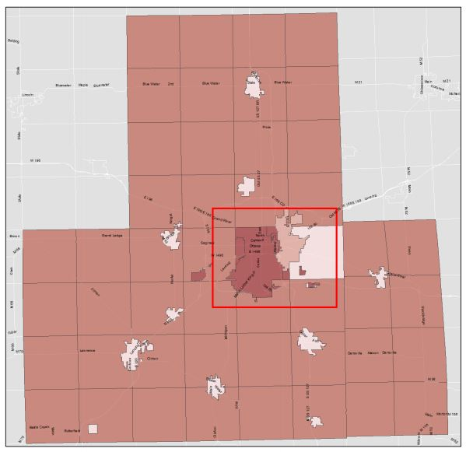
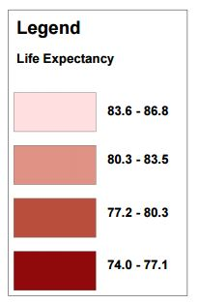
Mortality
Notes:
The overall statewide life expectancy is 78.3 years. The tri-county region has a negligibly higher expectancy of 78.6 years. Life expectancy in the within the tri-county area ranges from 74.0 years among residents of Lansing and 86.8 years for Small Cities.
The city of Lansing performs worse at nearly all levels of the rainbow table and as you can see, life expectancy is the shortest here.

Slide 16
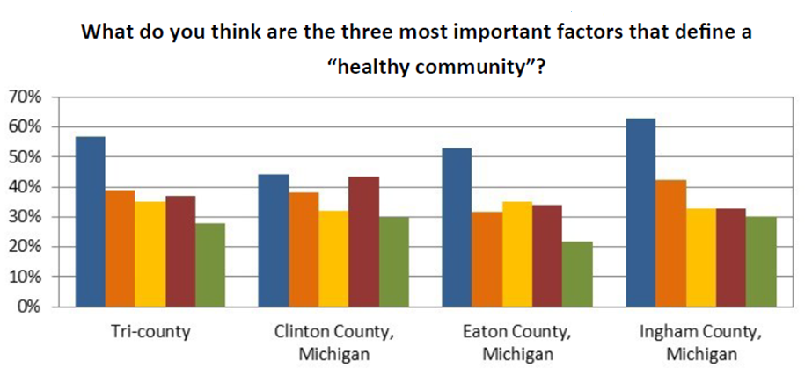
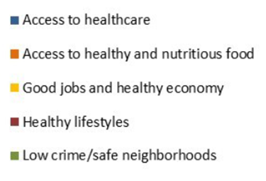
Community Survey
N=406
Notes:
The previous information was all data driven, but it was important to the Healthy! Capital Counties workgroup to provide an opportunity for anyone from the community to give their input about the health of the tri-county area. To facilitate this participation, we created an online survey that asked about the defining characteristics of a healthy community, the most important health problems in the county of residence and county of employment, access to health resources, social needs, and health care barriers. The Community Survey was available from July 21, 2015 to August 18, 2015.
Do you think “access to health care” is the MOST important factor in a “healthy community?”

Slide 17
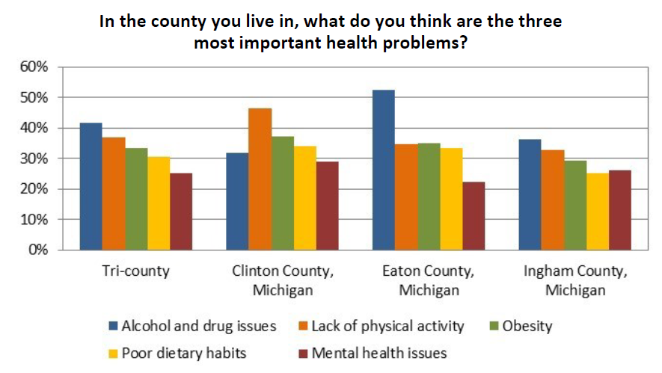
Community Survey
Notes:
Lack of access to health care was reported as a major health problem by a few, but not the majority.

Slide 18
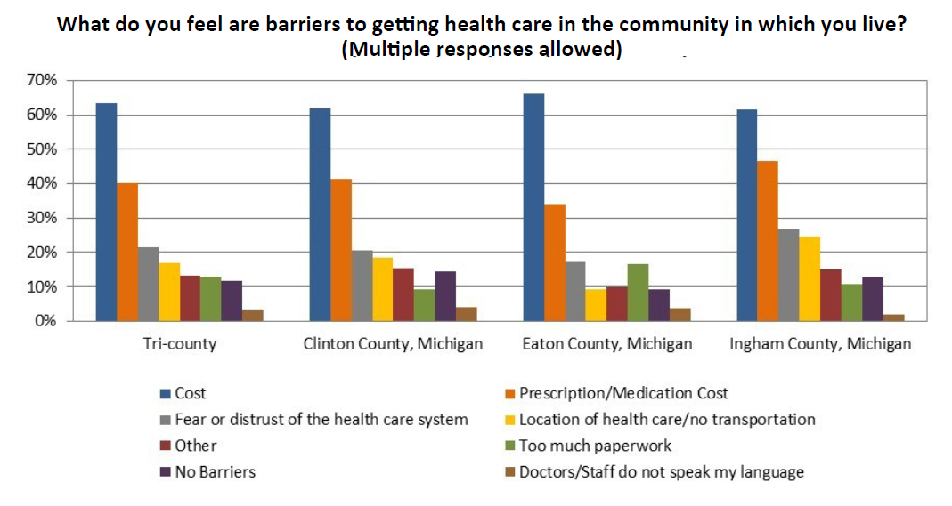
Community Survey
Notes:
These are perceived barriers to health care in the community. What do you think of them? Cost for the care itself or for medication was by far the biggest barrier across the board. Next is fear or distrust of the health care system.

Slide 19
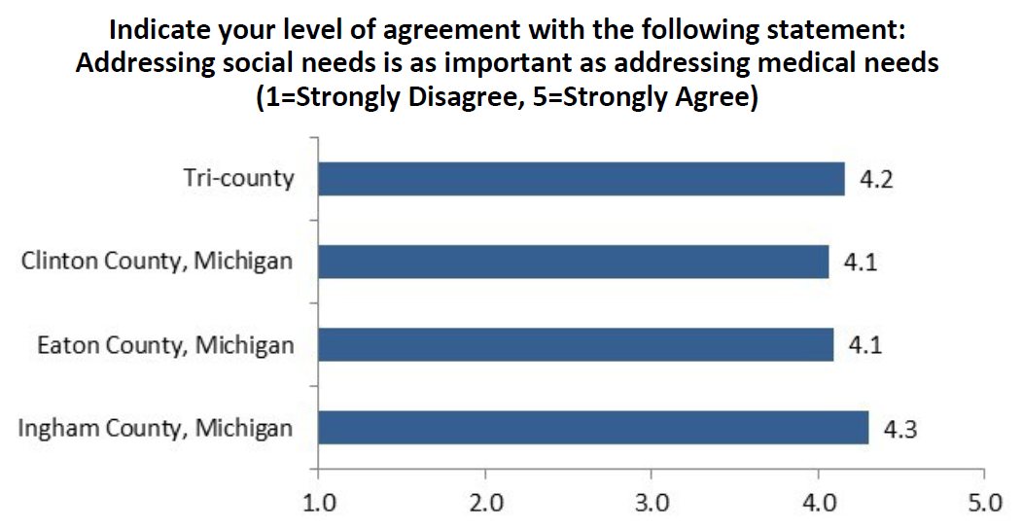
Community Survey
Notes:
Community members think addressing social needs is as important as addressing medical needs.

Slide 20
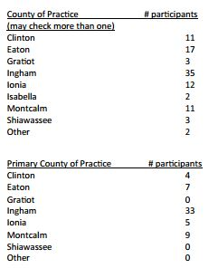
Provider Survey
59 Health care providers took the survey (52 completed it)
Notes:
In addition to the community survey, we specifically sought insight from local health care providers about the health of the community. Health care providers within the four hospital systems were encouraged to participate in an online survey that asked about the characteristics of a healthy community, the most important health problems in their county of employment, factors affecting patient health, referrals to other community resources, social needs of patients, and health care barriers. The Community Survey was available from August 5-21, 2015. Health care providers were invited to complete the survey via communication from their hospital system.

Slide 21
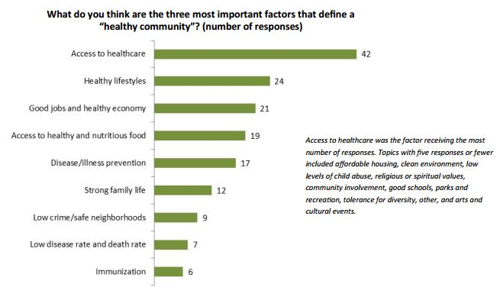
Provider Survey
Notes:
“What do you think are the three most important factors that define a healthy community?” “Access to Healthcare” was the factor receiving the most responses (this is consistent with the community survey). Four of the top five responses overlapped. The community placed “low crime/safe neighborhoods” in their top five and providers did not. Providers placed “illness/disease prevention” in their top five and the community did not.

Slide 22
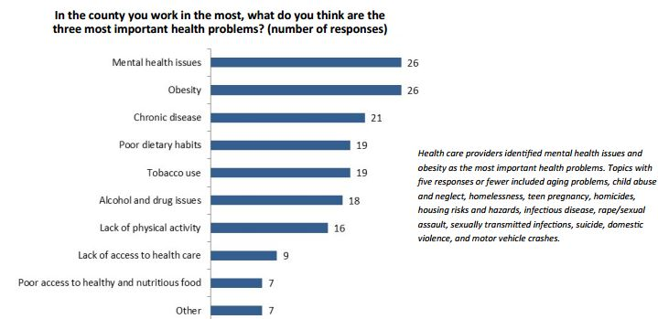
Provider Survey
Notes:
“What are the most important health problems?” Again, there is much overlap with the community survey.

Slide 23
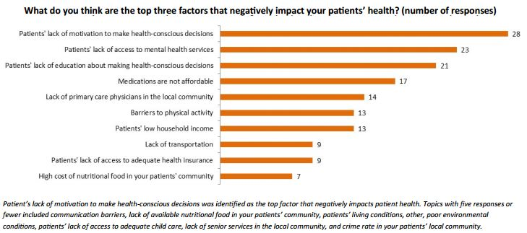
Provider Survey
Notes:
What do you think are the top three factors that negatively impact your patient’ health?
The number one answer is “lack of motivation.” The number three answer is “lack of education.” I found this interesting because it MAY be hard to differentiate between the two. Lack of access to mental health services ranked number two. Mental health came up many times during the assessment.

Slide 24
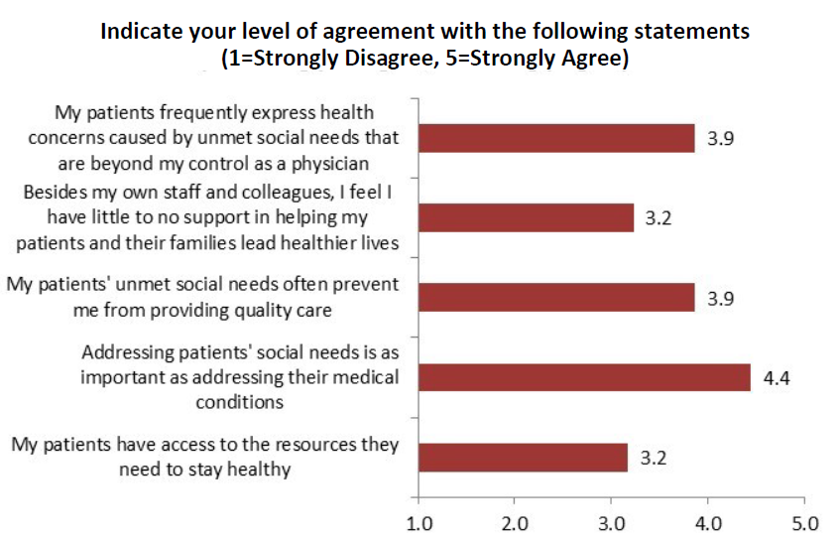
Provider Survey
Notes:
Local providers see needs beyond healthcare, beyond their control. Physicians actually agreed more strongly with the statement that “addressing patients’ social needs is as important as addressing their medical conditions” than the community.

Slide 25
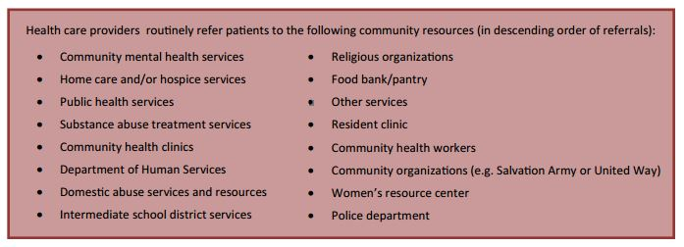
Provider Survey
Notes:
Local providers refer patients to community resources. This is one way to address other areas on the “rainbow table.”

Slide 26
Major Findings
The social conditions that promote health vary widely across the Capital Area.
This means people such as minorities, low-income and other vulnerable groups are often less healthy.
Chronic disease is the main killer everywhere .
Other health outcomes also vary geographically .
Substance abuse and mental health drive other health problems .
People still think of health care first, but also recognize the importance of social conditions .

Slide 27
Prioritization
Prioritization Exercise on October 21, 2015
68 Participants
24 Different issues identified
Methodology
Criteria established
Include root causes
Five priorities were identified

Slide 28
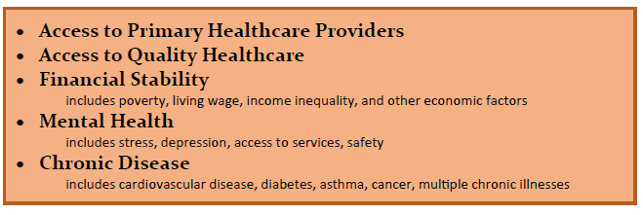
Five Priorities

Slide 29
Why This is Important
Coming changes related to the Affordable Care Act mean opportunities for prevention.
There will be new funding for community-based prevention .
Hospitals and health plans need community partners to help hold down costs.
Grants will require collaborative assessments and plans .
The Capital Area will be well-positioned to compete.

Slide 30
What Can You Do?
Use the assessment. You can pull out a two-page handout on a topic (such as poverty) or you can pull out a two-page handout on a geographic area (one county).
Tell us about it!
Consider addressing the priority health issues if you aren’t already. If you are, make sure to coordinate your efforts with others to maximize your impact. A great way to do this is through CAHA’s committees!

Slide 31
www.HealthyCapitalCounties.org

