Slide 1
Community Approaches to Recruiting and Retaining Physicians and Primary Care Providers
April 13, 2016
Allison B. McCarthy, Principal

Slide 2
Challenges Abound
Aging population
Expanded access
Shifting payment systems
Newer care models
Changing provider needs
Trends
Ideas from Others
Strategies

Slide 3
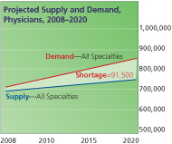
Physician Supply and Demand
Projected shortage of 62,900 and 91,500 physicians in 2015 and 2020 (active in patient care) – primary care representing nearly 50%

Slide 4
Physician Supply
850,000 active licensed physicians in the US

Slide 5
Age by Specialty

Slide 6
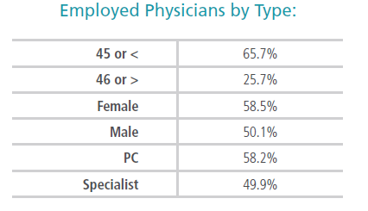
Likely to be Employed
Younger
Female
Primary Care

Slide 7
How Does Michigan Stack Up
Category | Michigan | US Average | US Median
Active Physicians per 100,000 (29,166) | 271.9 | 265.5 | 251.0
Active Patient Care Physicians per 100,000 (23,987) | 242.1 | 234.7 | 225.6
Active Patient Care/ Primary Care Physicians per 100,000 (8,756) | 88.4 | 82.5 | 83.0
Active Patient Care General Surgeons per 100,000 (705) | 7.1 | 6.9 | 7.1
Female Physicians as % of Total Active Physicians (8,768) | 32.0% | 33.2% | 32.4%
Active Physicians that are IMGs (7,891) | 29.3% | 24.2% | 18.6%
Active Physicians Age 60 or Older (7,965) | 29.8% | 29.4% | 28.4%
Residents & Fellows per 100,000 (as of 12/31/14) (4,995) | 50.4 | 36.9 | 27.3
Residents & Fellows in Pr. Care per 100,000 (as of 12/31/14) (1,732) | 17.5 | 13.6 | 10.5
Phys Retained from Undergrad Medical Education in MI | 43.6% | 38.7% | 38.5%
Phys Retained from GME in MI | 44.4% | 47.2% | 44.4%
Phys Retained that did Undergrad and GME in MI | 66.7% | 66.8% | 68.4%
2015 State Physician Workforce Data Book: AAMC, November 2015, based on 2015 AMA Masterfile
Green indicates where MI is above the US average and/or median

Slide 8
Recruiting Residents
Majority (68%) begin search prior to or early in final year
32% wait until six months before – fellowships, spouses, visa transitions
Most (93%) prefer communities of 50,000+
Limited formal learning on medical business – contracts, compensation, coding, and reimbursement
FREE TIME
63%
DEBT
INCOME
RESIDENTS APPROACHED BY RECRUITERS 51 OR MORE TIMES

Slide 9
Nurse Practitioners “NP”
>80% of NPs were prepared in Primary Care (2012)
49% of those in Family Medicine (vs. Women’s Health, Peds, Geriatrics)
Many practice in rural or inner city communities
Some opposition from AMA and AAFP relative to Scope of Practice expansion
State based practice distinctions
22 States plus D.C. currently recognize “Full Practice” scope for NPs
MI Law currently limits their scope of practice to “Restricted Practice”
2015 mean base salary was $97,083, with total income of $108,643

Slide 10
2015 Nurse Practitioner State Practice Environment
Full Practice
Reduced Practice
Restricted Practice
Source: State Nurse Practice Acts and Administrative Rules, 2015
© American Association of Nurse Practitioners, 2015
Updated 11.11.2015

Slide 11
Physician Assistants “PA”
MI ratio of PAs to NPs is 1.4 : 1
Currently approximately 104,000 PAs in US
190 accredited programs with annual graduates of 7,000+
Bureau of Labor Statistics projects that PAs will be the 2nd fastest growing health profession in the next decade (behind home-health aides)
1/3 practice in Primary Care, primarily Family Medicine
1/3 practice in hospital settings
12-15% overall and 20-25% of PAs in Primary Care practice in Rural areas
Median Salary in 2013 was $90,000 (not including bonus)

Slide 12
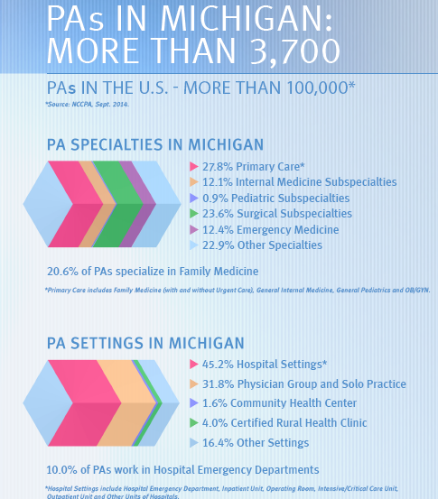

Slide 13
Ideas from Others

Slide 14
Address the Shortage
Entering other professions
Consider:
“Health Sciences Exploration” or “Clinical Rotations” classes
Experience through shadowing, internships, summer jobs or volunteering
Science fair awards at local, regional, state levels
“Show and Tell Career Fairs”
Science class lectures
Physician profession used to be self-replenishing

Slide 15
Early Influencers
Health Professions Recruitment and Exposure Program (HPREP) – University of NC School of Medicine
Expose high school students to medical students, faculty and health professionals
Ethnic minority groups across Research Triangle and central NC
Collegiate Fellows Program – Southwestern Medical Center
Nine week summer internship
25 undergraduate students selected
Placed throughout hospital and work 40 hours/week
Complement academic learning

Slide 16
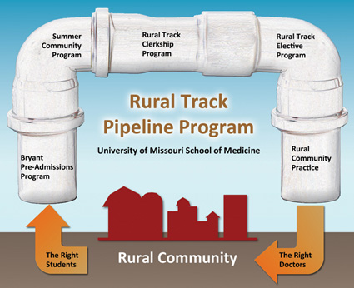
Influence During Med School/Training
GME location often matches practice location
Study showed > 40% moved < 10 miles residency; > 50% moved < 75 miles
MU School of Medicine demonstrated that half of graduates from Summer Community Program practice in rural locations. (15 year study)

Slide 17
Efforts with Residents
Program leadership connections
Medical staff
Physician leaders
Administrators
Hosting events
Boston Garden
North Carolina Zoo
System-wide career fairs
Residency/Fellowship Stipends
Scholarship awards
Early signing bonus
Dedicated recruitment FTE
Beyond Sending Flyers

Slide 18
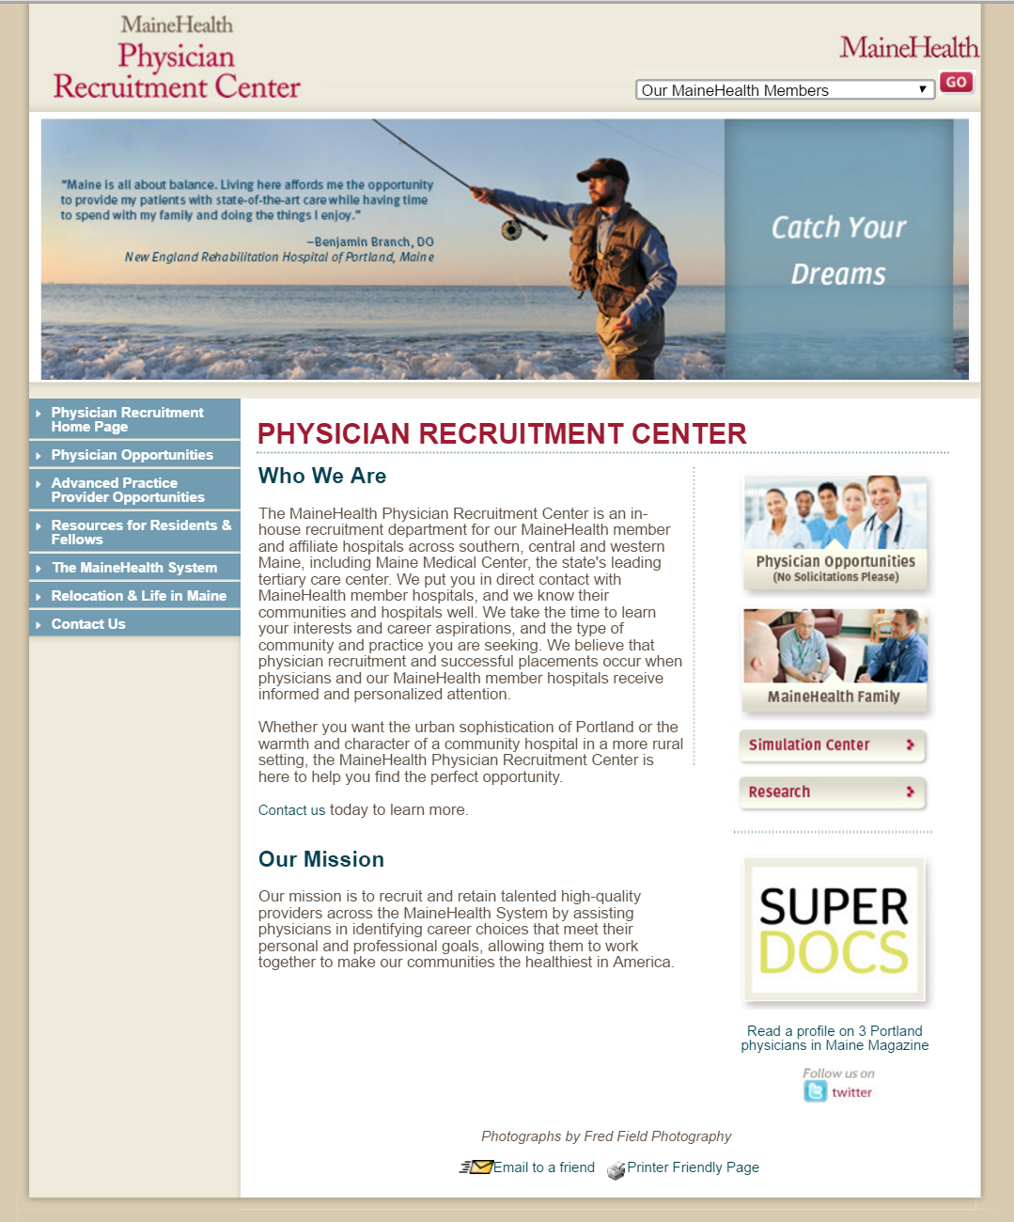
Why choose to live in central Michigan?

Slide 19
Strategies

Slide 20
Recruitment: Its About Them
Flexibility of schedules
Office hours
Part time versus full time
Call coverage
Employment or private practice
Give options
Evolve with their self-confidence
Teach the business aspects of practice
Cover additional training
Specialist to subspecialist
Transition from one setting to another

Slide 21
Competitive Compensation
Know what your competitors are offering
Richer retirement packages for practicing physicians
Utilize recruitment incentives
Get creative with incentive bonuses
Consider compensation for administrative activities

Slide 22
Change the Practice Model
Physician as clinical leader
Others as care providers
Also consider:
Mental health providers
Care coordinators
Educators/health coaches
Substance abuse professionals
5.6 physicians and 5.6 MAs
1.5 ACPs
1 Pharmacist
1.2 RNs
2.0 LPNs
10,000 patient panel
Group Health, Seattle, WA
Notes:
Allison Starts

Slide 23
Succession Planning
Education and mentoring
Emotional support during transition
Evolve out comfortably
Soft place to land
Longer than expected timeframe
Comfortable with “stops” and “starts”
Retain the practice and physician as long as possible

Slide 24
Increased Differentiation
Distinguish opportunities – beyond geography
Practice opportunity development
Takes place prior to search launch
Unique offerings
Office setting
Patients
Role definition
Define target populations and sourcing strategies
Attributes of those most likely to be interested
Adapt the opportunity to those available

Slide 25
Broaden Prospecting Tactics: Michigan Graduates
Target medical schools to identify early prospects
Capture list of medical students and residents with contact information
Ongoing interactions with program leadership
Some programs list residency selections during Match
Establish reasons for med schools to offer information
Scholarships and other similar financial offers
Career information and/or counseling support for training decisions
Special employment offerings for medical students between years one and two

Slide 26
Requires Advanced Planning
Strategic plans
Medical staff development plans
Succession planning
Recruitment cycle
New graduate season
Visa obligations
Family relocation preferences
Holidays

Slide 27
More Aggressive Recruitment Process
Candidate
Identification
To Initial
Contact
Initial
Contact to
Pre-Screen
Interview
Pre-Screen to
Site Visit (s)
Site Visit
To Offer
Offer to Signing
Average
1
Week
2
Weeks
6
Weeks
2
Weeks
8
Weeks
19
Weeks
Best
Practice
1
Week
3
Weeks
2
Weeks
6+
Weeks
24
hours
48
hours
Establish clear candidate criteria
Accountability for evaluations
Draft contracts in advance
Speed candidate closure
Limit to one site visit when possible
Compressing the Recruitment Timeframe to Improve Competitive Positioning
HCAB Study 2007

Slide 28
Other Strategies to Consider
Additional residency program slots
Postgraduate residency programs for ACPs
Primary care practice
Clinical specialty
Training to integrate physicians and ACPs
Alter the “shift work” mentality
Critical thinking skills
Scope of practice

Slide 29
Conclusion
Acknowledge reality
Short term and long term perspectives
Collective versus individual efforts
Promotion and differentiation
Continuously streamline process
Success Requires:
Multiple Strategies…
….Varied Approaches

Slide 30
Thanks!
Allison McCarthy
Principal
amccarthy@barlowmccarthy.com

